Slide 1

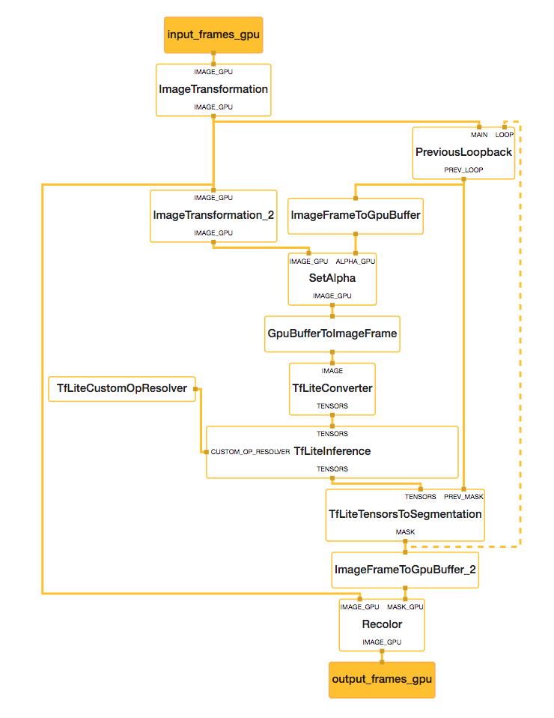
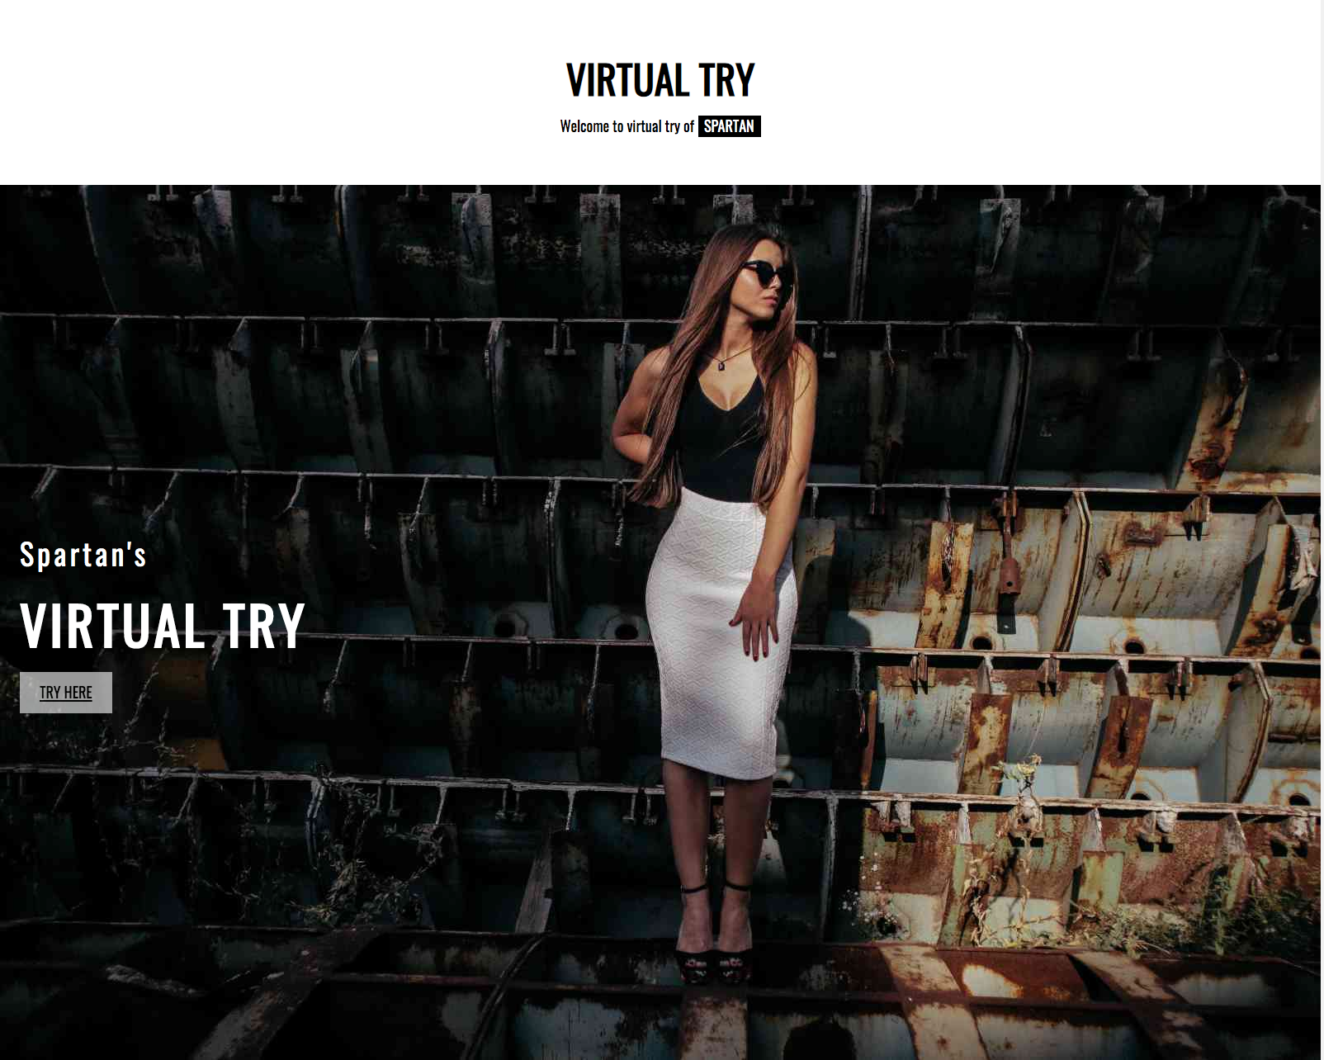
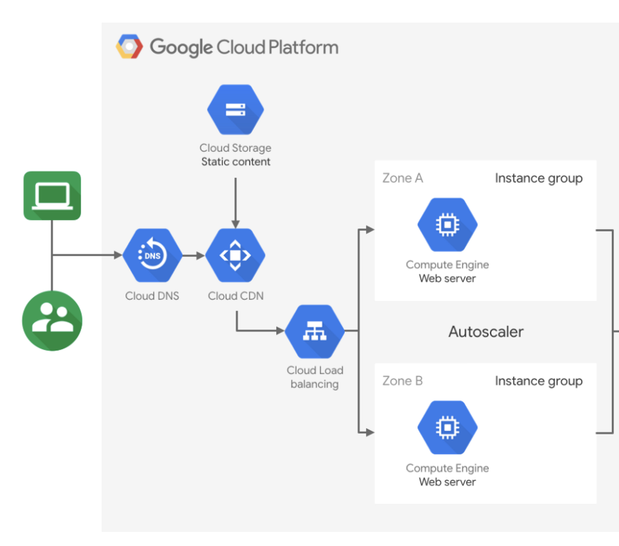
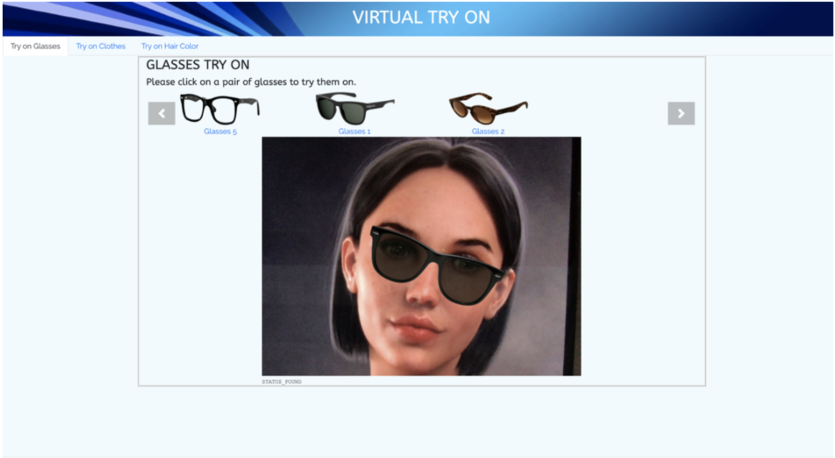
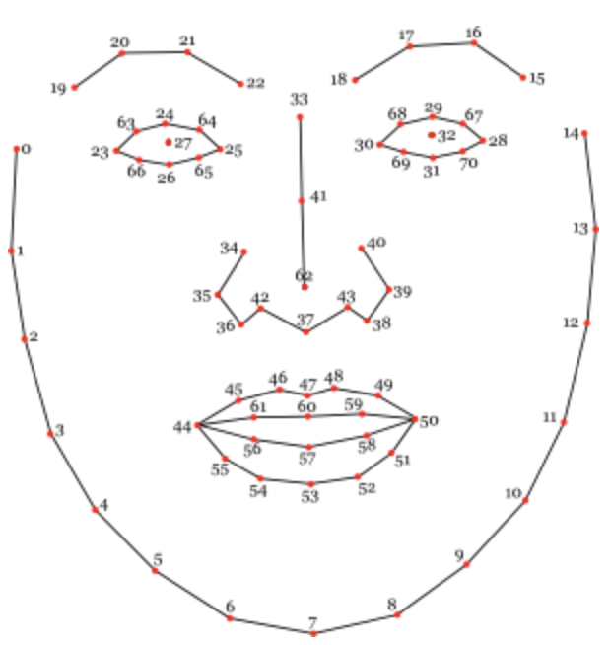
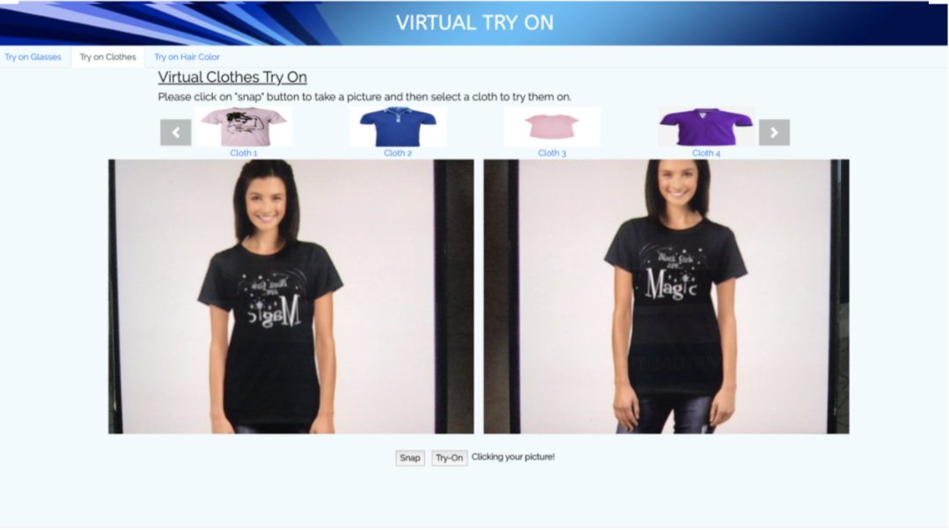
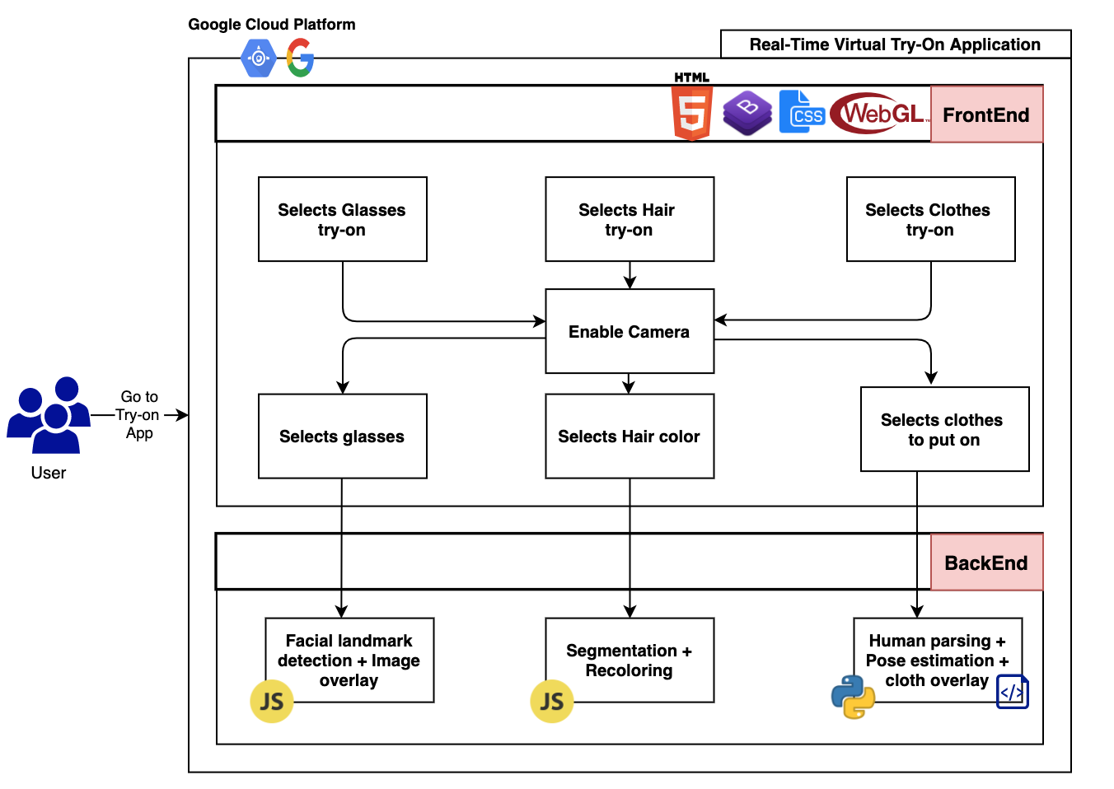
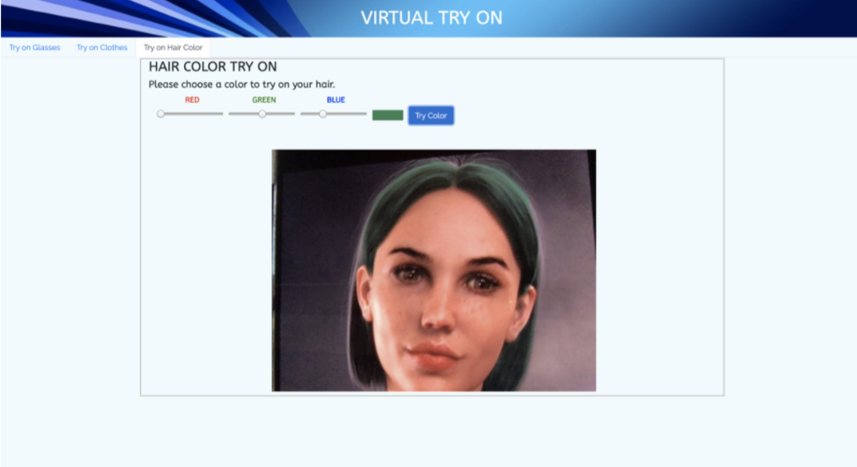
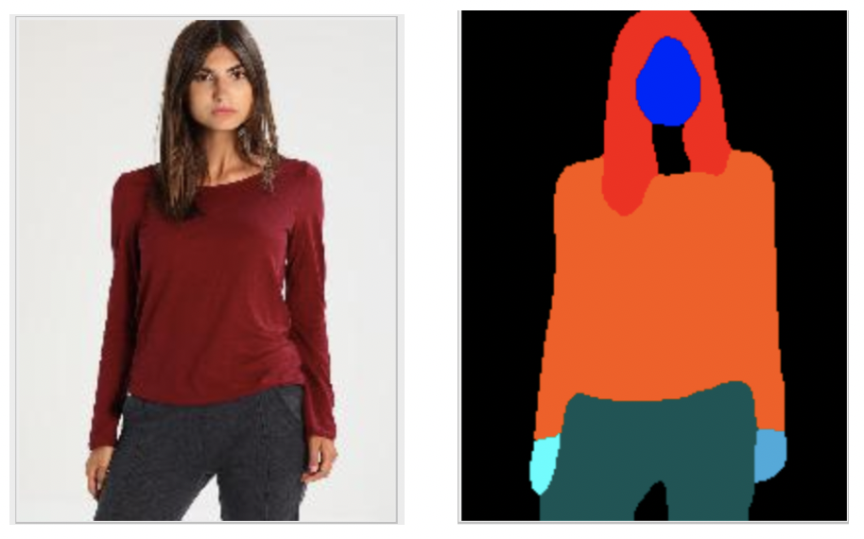
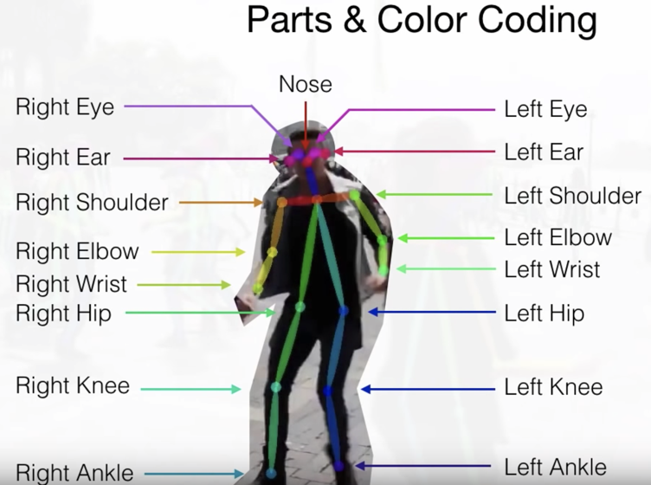
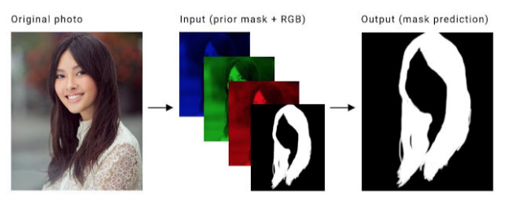
Software Engineering Department
Real-Time Augmented Reality for Virtual TryOn
Project Advisor: Prof. Vijay Kumar Eranti
Gautam, Pragya (MS Software Engineering)
Keykhanzadeh, Mojdeh (MS Software Engineering)
Krishna Murthy, Sithara (MS Software Engineering)
Shah, Vidhi (MS Software Engineering)
Introduction
Analysis and Results
Deployment
The entire web application, including both front-end and back-end is deployed within the google compute engine (GCE) instances. It automatically does scale the application. Instances can be started or stopped as per the need.
Configuration: n1-standard-8 having 8 virtual CPUs and 30GB memory along with Ubuntu 18.04 as the operating system with firewall open for both HTTP/HTTPS traffic
Virtual try-on is enhancing customers' experience by allowing them to try-on products even while browsing online, which traditionally was not the case.
Goal: Provide E-commerce customers with a system that allows them to virtually try on a variety of products in real time while preserving their privacy.
Advantages:
Simple site access
At home shopping
Real-time
Multi Platform support
User Privacy
Glasses Try-on
Feature: The users live video feed is captured and the default glasses are overlaid on the users face. If the user does not like the glasses, they have an option to browse through a catalog of glasses and select the ones they would like to try on.
Facial Landmark Detection
Deep learning model - CLMtrackr: To identify the position of the points of the eyes so that we can overlay the 3D glasses on the face of the customer.
Image Overlaying
JavaScript Library - Three.js: To overlay the glasses based on the position derived from CLMtrackr on the live video feed of the user.
Hair Recoloring
Hair recoloring can be done, once the segments are obtained for an image.
Summary/Conclusions
Cloths Tryon
Feature: The user captures an image of themselves from a live video, selects a clothing of their choice and tries it on. The model returns a users’ image with the clothing overlaid. If the user does not like the default cloth, they can choose a different one.
Human Parsing
Deep learning model - JPPNet: The parsing model will identify the different segments of the body, such as, head, arms, legs, ect.
Pose Estimation
Deep learning model - VGG19 & CNN: Model will determine the body points in the human pose.
Clothing Transfer
Deep learning model - VITON:
Stage-1 is responsible to do the inference by determining the mask to be put on a person's image based on body points and sample clothing to put on.
Stage-2 will do further refinement on the generated results from the stage-1 and generate the final results.
In this project, we provide a solution for virtual try on for a catalogue of products. The three products focused on are glasses, hair coloring and clothing. This is achieved using pre-trained models for facial landmark detection, hair segmentation, human parsing and pose estimation respectively.
We have created an application that can be very beneficial to not only big e-commerce companies, such as, Walmart, Amazon, Ebay, etc. but also to small mom and pop shops.
In the future we would like to extend out application to support more products such as makeup and jewelry
Methodology
Hair Color Try-on
Feature: The users live video feed is captured and the users hair is turned into the default hair color, purple. If the user does not like the default hair color, they can choose a different color by adjusting the sliders to the desired RGB intensity.
Implementation: We use a Mediapipe graph framework for creating a Machine Learning pipeline
Hair Segmentation
Segmentation model is used to identify hair of the user in their live video feed separating the hair from the background for each frame of the input.
Architecture
Three try-on features power packed in a single robust application. Overall architecture diagram is shown below with subsystems.
Key References
[1] Tkachenka, A., Karpiak, G., Vakunov, A., Kartynnik, Y., Ablavatski, A., Bazarevsky, V., & Pisarchyk, S. (2019). Real-time Hair Segmentation and Recoloring on Mobile GPUs. ArXiv.org, ArXiv.org, July 15, 2019.
[2] Saragih, J. M., Lucey, S., & Cohn, J. F. (2009). Face alignment through subspace constrained mean-shifts. 2009 IEEE 12th International Conference on Computer Vision. doi: 10.1109/iccv.2009.5459377
[3 ] Liang, X., Gong, K., Shen, X., & Lin, L. (2019). Look into Person: Joint Body Parsing & Pose Estimation Network and a New Benchmark. IEEE Transactions on Pattern Analysis and Machine Intelligence, 41(4), 871–885. doi: 10.1109/tpami.2018.2820063
FrontEnd: HTML5, CSS, Bootstrap, Javascript, jQuery and WebGL(JavaScript API is also used for rendering 2D and 3D interactive graphics)
Backend: Node.js, Django Web Framework, UNIX Shell Scripting
Deployment: Google Cloud Platform(Compute Engine Instance)
Acknowledgements
We would like to thank Professor Vijay Kumar Eranti and Professor Dan Harkey for their invaluable comments and guidance during the course of the project.

